Slide 1
CPT898: Foundations of Social Science Research Nov 2016
Cross-sectional, Longitudinal and Experimental Research Designs

Slide 2
Lecture Overview
What is research design?
Cross-Sectional
Repeat-Cross-sectional
Longitudinal
Experimental Designs

Slide 3
What is Research Design?
The research design provides a framework for the collection and analysis of data. A choice of research design reflects decisions about the priority being given to a range of dimensions of the research process. These include the importance attached to:
Expressing causal connections between the variables
Generalising to a larger group of individuals
Having a temporal appreciation of social phenomena and their interconnections
Understanding behaviour and the meaning of that behaviour in its specific social context (Bryman, 2012:46)

Slide 4
Research Design & Research Questions
Research questions / hypotheses inform the choice of research design. The ability to answer most research questions is dependent on using the correct research design
The function of research design is to ensure that the evidence obtained enables us to answer the initial questions as unambiguously as possible. De Vaus (2001:9)
For example, how can you measure changes over time with a one-off survey?

Slide 5
Good practice in developing a Design
Anticipate alternative explanations before collecting data
For example, an observed increase in divorce rates following introduction of no fault divorce legislation may be explained as:
No fault divorce directly causes increase in divorce
Plausible rival explanations
NFD leads to devaluing of marriage
NFD is a response to increasing marriage breakdown
Any increase in divorce – simply a catch up in formalising ended marriages
Any increase – simply long term trend – would’ve happened anyway
Design the collection to obtain context and comparisons. This will reduce ambiguity of data

Slide 6
Principal Types of Research Design
Cross Sectional
Longitudinal
Case studies
Experiments, Randomised Controlled Trials (RCTs)

Slide 7
Research Design and Methods
Research design is distinct from methods
“A study that followed infants from birth to adolescence weighing them on 1st January every year would be longitudinal in design. A study that followed infants from birth to adolescence, interviewing their parents about their happiness every year, would also be longitudinal. A study that did both of these would still be longitudinal, even though some commentators would, distractingly and pointlessly, categorise the first study as ‘quantitative’, the second as ‘qualitative’, and the third as ‘mixed methods’.”
Gorard, S. (2013) Research Design. (p6-7)

Slide 8


Cross-Sectional Research Designs

Slide 9

Cross-Sectional Designs
Provide a snapshot at a point in time
Allow you to assess prevalence or average
For example:
What is the average income?
Are there differences between groups?
Identify existing differences, relationships between groups
Need to think about groups beforehand and be aware of sample size

Slide 10
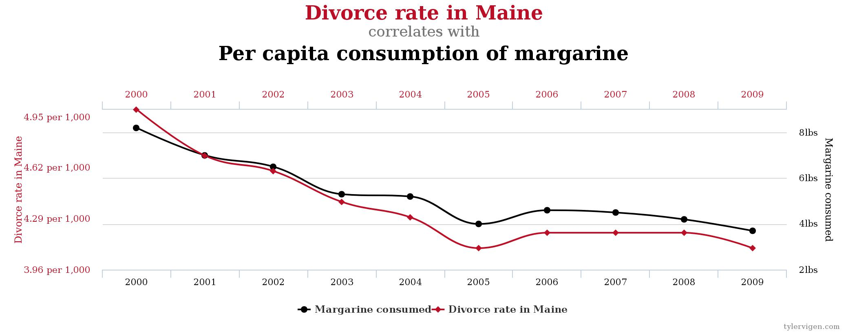
Spurious Correlation 1

Slide 11
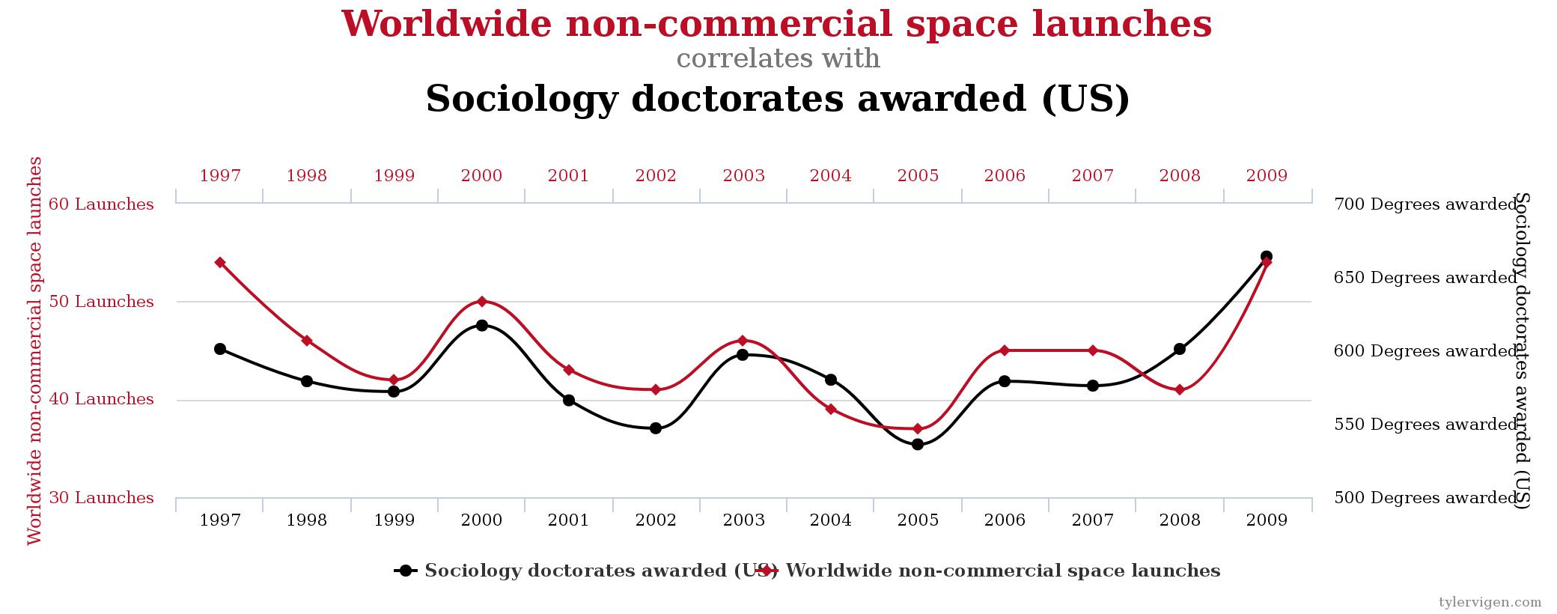
Spurious Correlation 2
http://tylervigen.com/spurious-correlations

Slide 12
Frequencies

Slide 13
Comparisons: Likelihood of Fire

Slide 14
Why is risk of fire perceived to be a major risk by seafarers aboard ship?
I mean if it’s a major fire, then we’ve got the equipment but we don’t have the manpower for a major fire. That’s why we’ve got a lifeboat so we can all just get off. (Captain )
Well we’re such a small crew. If there was a fire in the engine room…You probably have no chance … Not enough people. (chief officer)
a ship this size, if we had a big fire, how many fire fighters would you have down on the quay to fight it, there would just be hundreds of people round, there’d be all kinds, specialists, but we’re expected to fight it with what, 24 people on board, of which you’re going to have 2 people on the bridge, you’ve got to have 2 people in the engine room, the electricians going to be running around, there goes 5, you’ve got 19 left - 4 of them are out of the game because they’re cooks and stewards and they’re just not interested, they’ve got no experience of what’s going on. … so you’re down to very few, realistically what equipment have we got as well to fight an incident, a dangerous cargo fire on deck (Navigator)
if you had to go in and fight a fire I think you would struggle. The first wave would be fine, but once you got in there it’s maybe the third attack when you’re going in you’d start to get a bit thin on the ground (Chief Engineer)

Slide 15
Cross-Sectional Designs: Limitations
Cannot measure temporal elements: asking someone what something was like before as compared to now is not capturing temporal change
Cannot measure causal relations only associations
Cannot be used to measure the effects of social policies or interventions although frequently (e.g. poor educational evaluation post-event)

Slide 16
Cross-Sectional Designs: Examples
Despite the problems, cross-sectional designs are very common and used in many studies including:
Evaluation and customer service research
e.g. National Students Survey (NSS)
All undergraduate final year students in UK HEIs
Online, postal and telephone

Slide 17
Repeated Cross-Sectional
Research Designs

Slide 18
Repeated Cross-Sectional Designs
We can get a better understanding of change if we repeat cross-sectional studies over time
However this would involve surveying different samples at each time point (multiple independent samples)
Danger of confusing changes over historical periods with changes in the life of individuals.
That is, repeated cross-sectional surveys allow you to answer questions about social change (but not individual changes over time which requires a ‘cohort’ study)

Slide 19

Examples of repeated cross-sectional designs include:
British Social Attitudes Survey
Conducted annually since 1983 (exc. 1988 and 1992)
Samples around 3,000 people every year
Over 80,000 participants so far
Topical issues (social, political and moral attitudes)
General Lifestyle (Household) Survey
Conducted annually since 1971 (exc. 1997/8 and 1999/2000)
Consists of a continuous component (constant 2000-2004)
Also a ‘modular’ component which can change
Introduced a longitudinal component in 2005/06

Slide 20
Longitudinal Research Designs

Slide 21

Longitudinal Designs
Longitudinal designs repeatedly collect data from the same sample of individuals (or families) at repeated (>2) time points
Allow us to measure changes in this ‘cohort’ of individuals over time

Slide 22
Longitudinal Designs: Examples
Studies that follow the same group (‘cohort’) over an extended period of time include:
1958 National Child Development Study (17,500 people born in 1958)
Children surveyed at 7, 11, 16, 23, 33, 42, 46 and 50
Includes DNA data
Supplementary data from 1971 and 1981 Censuses
School leaving examination results collected in 1978
Millennium Cohort Study (18,000 people born in 2000/01)
Allowed for seasonal effects (whole year sample)
Covers whole of UK inc. N. Ireland
Fathers interviewed as well as mothers (more than 1 respondent)
Children surveyed at 9 months, 3, 5 and 7 years
Includes saliva samples
Linked to routinely collected data (e.g. National Pupil Database)

Slide 23
An example: Changes over time & between groups
While the pay gap between men and women is reducing, the rate of reduction is slowing and varies over the lifecycle
For those women born in the years 1965-74, the current pay gap is 8% less than it is for those born 10yrs earlier
By contrast, those born 1977-84 are only 2% better off than women born in 1965-74
If the pace of change continues at this rate = equal pay achieved in 150 years
Manning, A. (2006) ‘The gender pay gap’, CentrePiece, Summer. London: CEP Discussion Paper, 700. http://cep.lse.ac.uk/pubs/download/dp0700.pdf

Slide 24
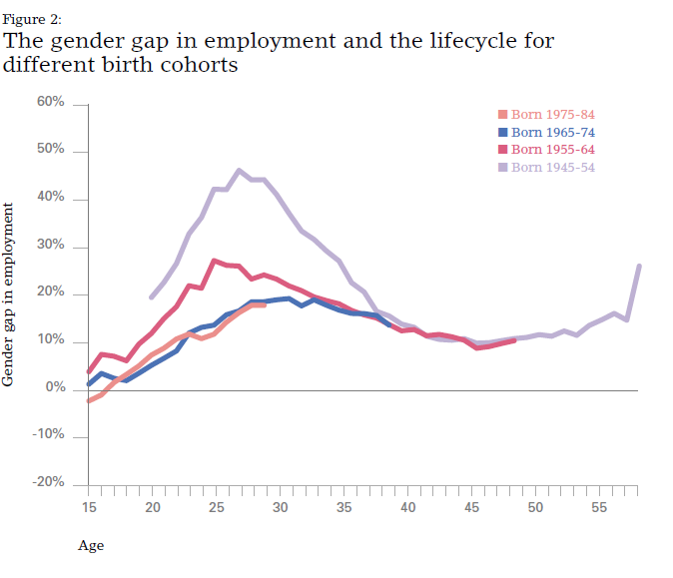
Variations in inequality over the lifecycle

Slide 25
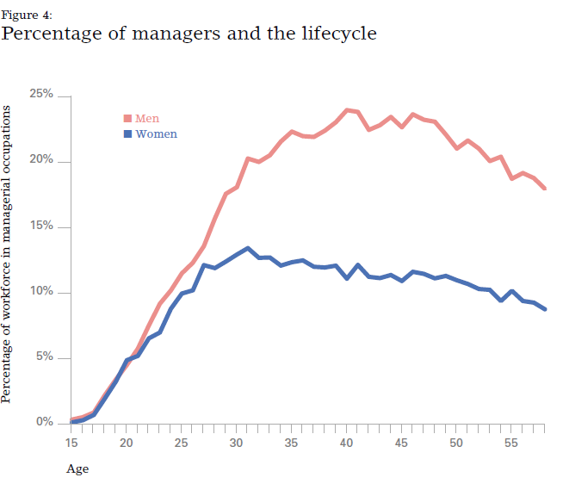
A glass ceiling in late 20s?

Slide 26
As social scientists we need to be very careful about claiming causal links…
DIRECT CAUSAL
Income Level
Sex
INDIRECT CAUSAL
Field of Training
Promotion Opportunities
Income Level
Sex
Occupation
Field of Training
Occupation
COMPLEX DIRECT & INDIRECT CAUSAL
Income Level
Sex
Childcare Responsibilities
Part-time or Full-time Work
Source: de Vaus, 2011

Slide 27
Experimental Research Designs

Slide 28

Experimental Designs
Typically used in the natural sciences
In a controlled environment (usually a laboratory) a single variable is changed and the outcome measured
Experiments in the social world can only emulate those in the physical world

Slide 29

Randomized Control Trials (RCTs)
Traditionally used in medicine and epidemiology, now commonly used in educational evaluations, gets closest to experiments in natural sciences by substituting randomisation for physical control
RCT is a longitudinal study in which participants are randomly allocated into ‘study’ (or treatment) and ‘control’ groups
The two groups must be the same in all relevant ways at the outset and participants, covered by random selection
Measure before and after intervention (t1 and t2). You must measure the same thing before and after (i.e. use same questions)
You only change a single variable – everything else is constant
Any measurable difference between the two groups is either due to intervention or chance – this can be quantified
Hence, good for measuring the causal effect

Slide 30
Stages of RCT
MRC guidelines recommend three pre-intervention stages in development of an intervention and RCT.
Initial design of intervention
Ensure grounded in theory and have explicit interpretation of casual mechanism
Using primarily qualitative methods conduct formative evaluation intervention to identify how it is working, potential barriers and facilitators
Intervention tested in a feasibility study where implemented and tested for acceptability to providers (e.g. teachers) and target audience
Moore, et al (2003)

Slide 31
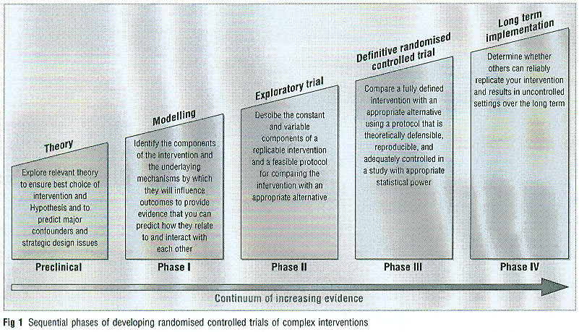
Stages of RCT

Slide 32
Methodological issues in RCTS
Time consuming
Expensive
Maybe demanding of participants and researchers
The sampling issue (selection effects)
Drop out and non response
What is the treatment / intervention, can it be standardised
Violation of assumptions (interaction effects)
Ethical issues

Slide 33
Quasi (natural) Experiments
Similar principles but no random allocation and conducted in social settings
Control may be non-existent or partial
Interaction effects
The Hawthorne effect
The small n problem
Hence identification of causality more open to question
Example: Employee reactions to an open plan office (Oldham and Brass, 1979)
Notes:
Previous literature suggested that open plan offices facilitate employee interaction improving personal satisfaction, motivation and performance.

Slide 34
An Example
Employee reactions to an open plan office
Previous literature suggested that open plan offices facilitate employee interaction improving personal satisfaction, motivation and performance
Oldham, G., and Brass, D. (1979) ‘Employee Reactions to an Open-Plan Office: A Naturally Occurring Quasi-Experiment’, Administrative Science Quarterly, 24(2):267-284

Slide 35
Example: Context
Newspaper organisation move from conventional cellular offices connected by corridors to open plan office block
New office block approx. same square footage as original office space
No change in salaries, job classifications or duties
Workers informed of planned change from outset

Slide 36
Example: Data collection
3 data collection points:
T1: 8 weeks prior to move
T2: 9 weeks after move
T3: 18 weeks after move
Data collected via questionnaire, informal conversations and interviews

Slide 37
Example: Measurement
Questionnaires measured 15 variables, including: work satisfaction, interpersonal satisfaction, internal motivation, autonomy, friendship opportunities, task feedback, etc.
Informal discussions: to gather reactions to move
Interviews: to ascertain if any other major changes in working environment had occurred.

Slide 38
Example: Participants
In organisation = (n=140)
In study (n=128)
In all 3 data collection waves (n=76)
Drop out (n=21)
Control group (press office) (n=5)
Already working in an open plan space
Quasi control group (n=26)
Only completed T2 and T3

Slide 39
Example: Findings
Exposure to instrument did not affect results
Between T1 & T2 motivation and satisfaction with work & colleagues declined sharply
Control group showed no significant difference between T1 & T2
No changes between T2 & T3, so affects resulted from change T1-T2
Interview data supplemented findings: with employees describing new office space as:
‘Fishbowl’, ‘cage’ or ‘warehouse’
Reported difficult to have private conversations, give feedback, and to concentrate due to noise

Slide 40
Summary
Research design is different to methods. Different designs allow you to make different types of claim relative to temporality and causality.
Cross-Sectional ‘survey’
Assess prevalence or average and/or how this varies by group
Repeated cross-sectional surveys
Assess trends / social changes
Longitudinal study (or ‘cohort’ study)
Examine individual changes over time & ‘predictive’ variables
Experimental study / RCT
Measure effect of a policy or intervention

